Slide 1


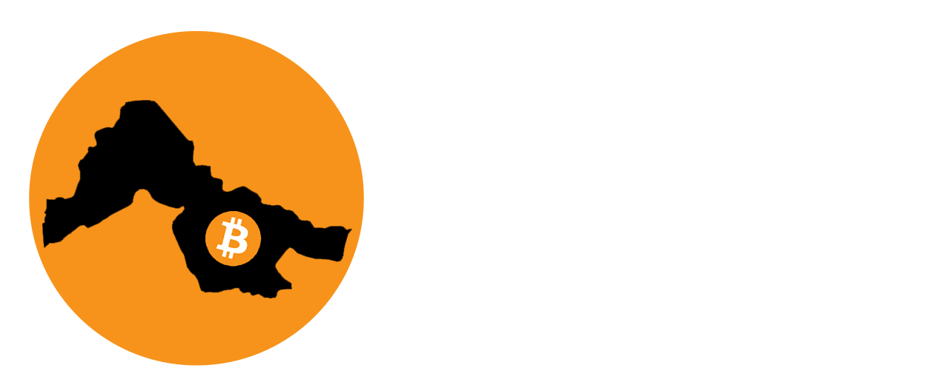

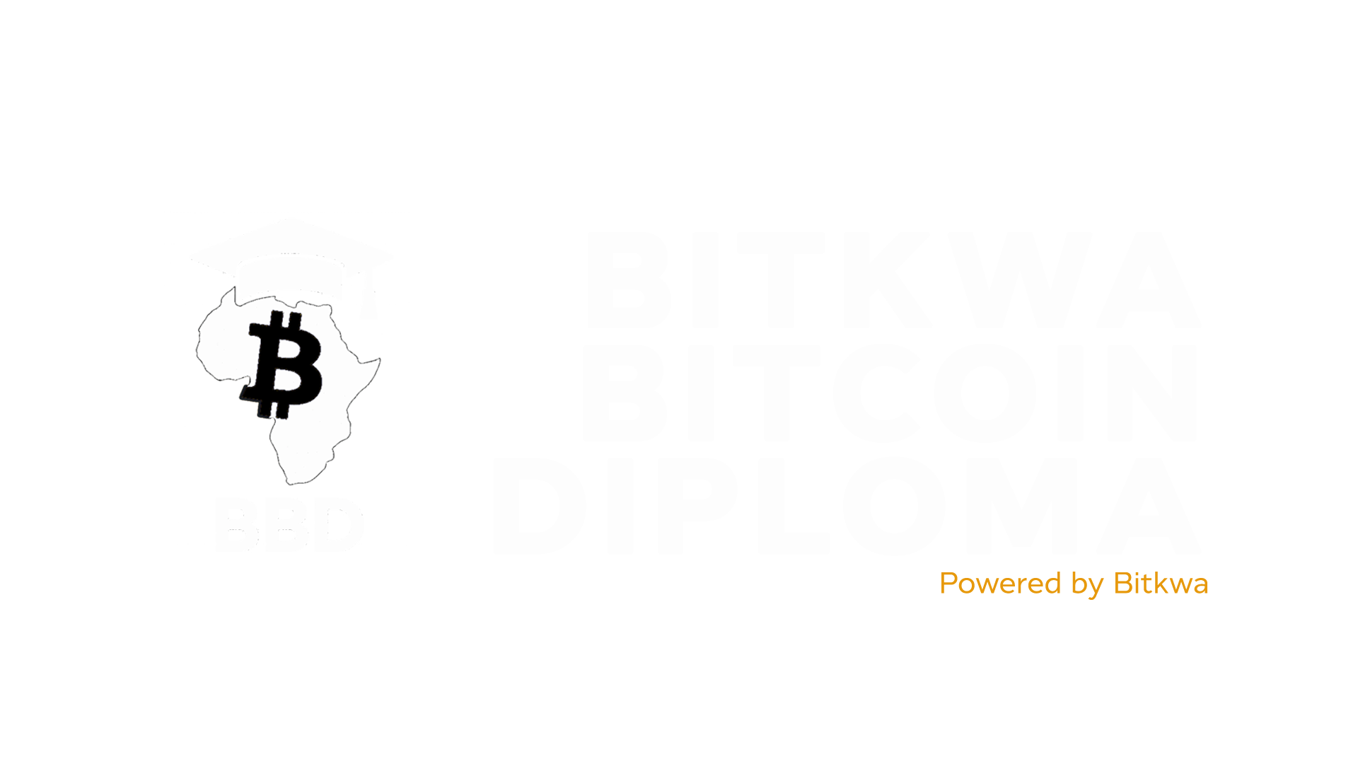


Slide 2
Chapter #3
Bitcoin
Introduction & How to Use It

Slide 3



Introduction to Bitcoin

Slide 4


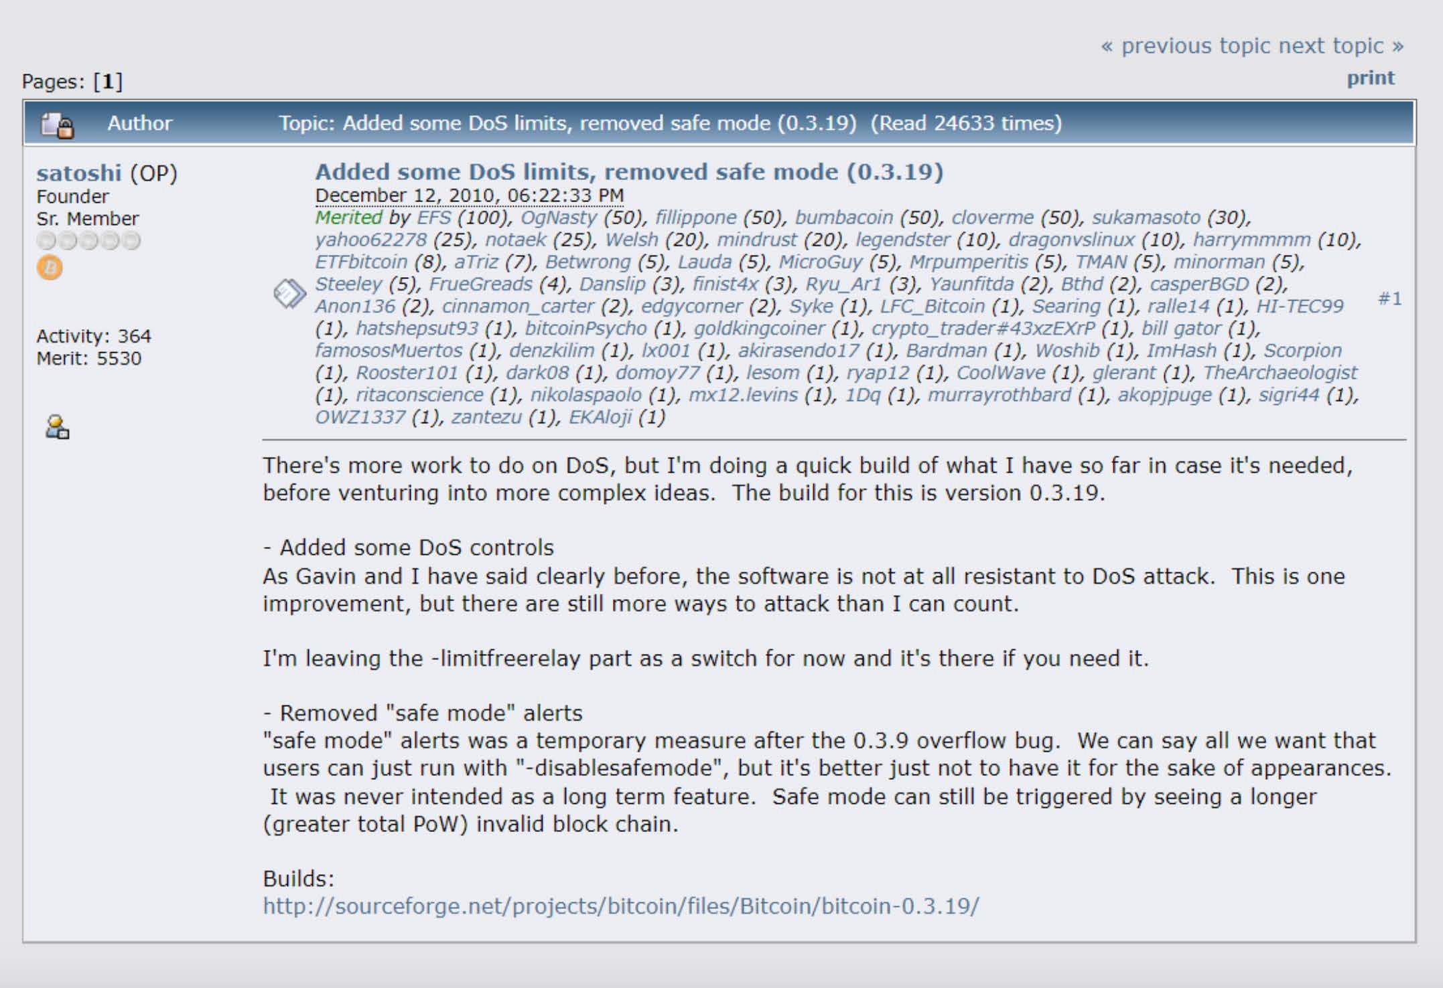
An Introduction to Bitcoin
Satoshi Nakamoto and the Creation of Bitcoin
A lot of people automatically dismiss e-currency as a lost cause because of all the companies that failed since the 1990s. I hope it's obvious it was only the centrally controlled nature of those systems that doomed them. I think this is the ﬁrst time we’re trying a decentralized non-trust-based system.
Satoshi Nakamoto
As you read in the previous chapter, multiple Cypherpunks attempted to create an alternative money system. This chapter continues the story of one of them: a visionary mind by the name of “Satoshi Nakamoto.” This anonymous person (man, woman, or group), long before Bitcoin, was one of the cryptography enthusiasts like computer scientists and hackers, engaging in discussions to ﬁnd practical solutions to replace the ﬁat system.

Slide 5
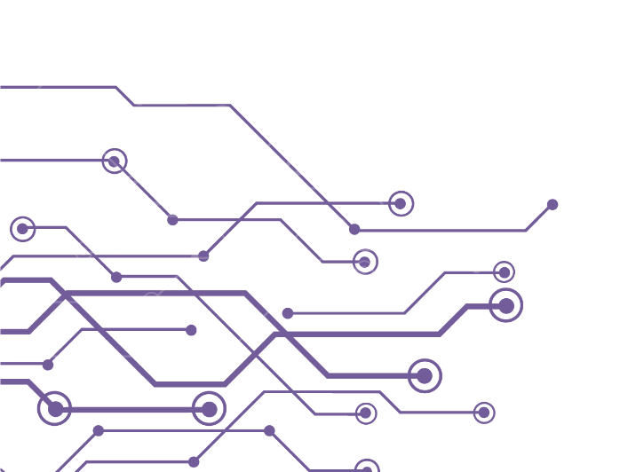
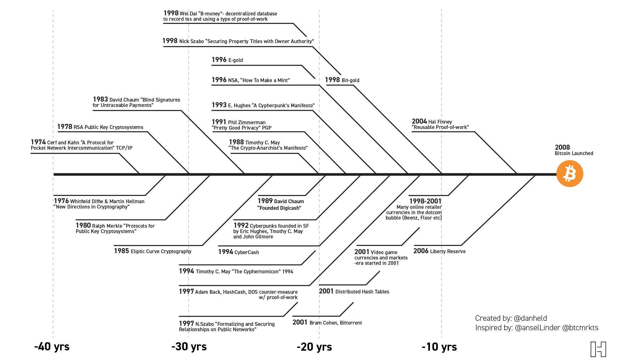
Bitcoin’s Creation
It’s the result of 40 years of research, development and demand.
-40 years
-30 years
-20 years
-10 years

Slide 6
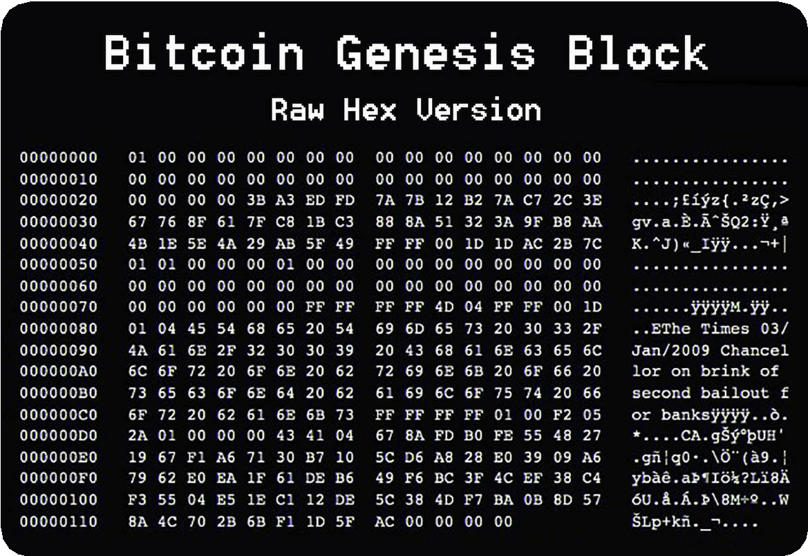
An Introduction to Bitcoin
In October 2008, Nakamoto unveiled a groundbreaking whitepaper titled, “Bitcoin: A Peer-to-Peer Electronic Cash System” on a cryptography mailing list. This document laid the foundation for a decentralized peer-to-peer protocol, designed to facilitate secure online transactions without the need for intermediaries.
Nakamoto's vision was clear: to create a purely peer-to-peer version of electronic cash, free from the control of powerful governments and ﬁnancial institutions.
Fast forward to January 3, 2009, when Nakamoto mined the ﬁrst Bitcoin block known as the "genesis block." This marked the oﬃcial launch of the Bitcoin network, a new money system built on trust and security through a decentralized ledger. In the months and years that followed, more and more enthusiasts started to join and contribute to the idea.
In 2011, after the Bitcoin network proved it could operate successfully without the need of its inﬂuential creator, Nakamoto sent an email to a fellow Bitcoin developer, announcing they were removing themselves from the Bitcoin scene and giving its future away to other “good hands” that shared their vision.

Slide 7
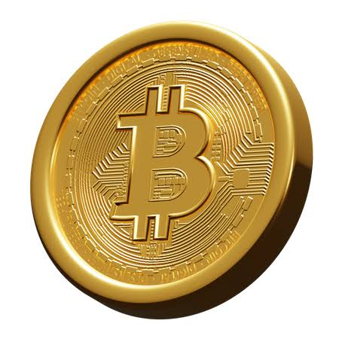
An Introduction to Bitcoin
Although Nakamoto’s identity remains a mystery until this very day, their goal for creating Bitcoin was never a mystery. In essence, Nakamoto created it to take the power away from the few and give it back to the many by creating an alternative in the form of a decentralized, open-sourced, transparent money system, separating money from the state. Creating Bitcoin was Nakamoto’s response to the 2008 ﬁnancial crisis that hurt regular people worldwide while enriching the elite class — again. Bitcoin was Nakamoto’s answer to the corruption and fragility of the ﬁat system. Nakamoto set the foundation for a new revolution and walked away from it instead of claiming credit.
In the years that followed, Bitcoin started to grow quickly and emerged as a symbol of hope, empowerment, and resilience, challenging the ﬁat system and providing a secure, censorship-resistant means of ﬁnancial transactions. Bitcoin is an
open-source protocol, meaning that no one has the power to own or control it. Its design is public and open for anyone to participate.
Today, Nakamoto's dream of a borderless, transparent, and secure ﬁnancial system lives on, empowering the global freedom revolution we are witnessing today.
Every day, ordinary people are opting out of the ﬁat system and into the world of Bitcoin. Bitcoin hubs — the so-called Bitcoin circular economies — have been launched by freedom enthusiasts in regions all over the world. Even entire countries looking for an alternative path, like El Salvador, are starting to adopt Bitcoin in their own ways.

Slide 8


An Introduction to Bitcoin
How Does Bitcoin Work?
The Nakamoto Consensus Mechanism
The key idea behind how Bitcoin operates can be condensed into one sentence: Bitcoin is an agreement among people online. You can think about it like playing a board game with friends. With a game like Monopoly, you are in agreement with the other players about speciﬁc rules. One of the rules of Monopoly is that only special “Monopoly bills” are to be accepted. If James, (one of the players), went against the rules by using toilet paper to buy a house instead of Monopoly bills, the other players would tell James he is a cheater and would simply stop playing with him. In short, to play the game, you have a consensus on a set of rules with each other and you do not drift away from those rules, otherwise you will be rejected.
This is essentially how Bitcoin works. Bitcoin is a network of people that agree on the same set of rules. These rules are mathematically bound, written in computer code, and accepted directly by everyone who runs the Bitcoin software. The rules of Bitcoin apply to all participants equally, which means that everyone either follows the rules of the game or cannot play because the network will reject them.
However, Bitcoin is not yet widely adopted. It is still a pretty new technology, like the internet was during the 90s. Because of this, it can be helpful to grasp the basics of Bitcoin in a simple, less technical way.

Slide 9





An Introduction to Bitcoin
One of the rules of Bitcoin is, "There will never be more than 21 million bitcoins." If someone wanted to create a million extra bitcoins for themselves, it would be of no use to them because they would automatically be identiﬁed and rejected by everyone else. This is what makes Bitcoin so robust.
It does not matter who you are or where you come from; if you enter the Bitcoin world, you need to play by the same set of rules as everyone else.
This also applies to all the people and entities with an enormous amount of control and inﬂuence in the ﬁat world. In the Bitcoin world, there is no room for cheating or sabotage — everyone is treated equally, and no one can change that.
Did you know that, since 2009, Bitcoin has withstood tens of thousands of attempts to hack, tamper with, or alter it?
Bitcoin has proven that nobody can stop, control, or manipulate it.
The Players of the Game
To better understand the decentralization of Bitcoin, we need to dive deeper into the diﬀerent roles within the network. In the Bitcoin world, various participants play distinct yet harmonious roles, contributing to the network’s seamless functioning.

Slide 10
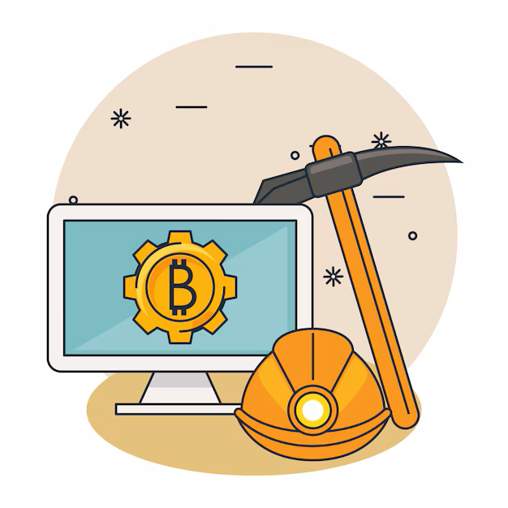
An Introduction to Bitcoin
1. Miners: The Architects of Security
Miners are the backbone of Bitcoin. These are people or groups of people who work behind the scenes to maintain and secure the network through a mechanism called Proof-of-Work (PoW). These players are armed with special computers that have heavy computational power. They make their hardware available to the Bitcoin network, competing with each other in a worldwide lottery to add new blocks of transactions to Bitcoin’s decentralized ledger (the blockchain). Their commitment ensures the ledger’s immutability and guards against malicious attacks.
Mining’s decentralized nature allows anyone with suﬃcient computing resources to participate. Because of their hard work, the miners who solve the puzzle the quickest are rewarded in the form of bitcoins.
Bitcoin miners are distributed all over the world, safeguarding the network against centralization and ensuring Bitcoin's security stays robust and distributed.

Slide 11
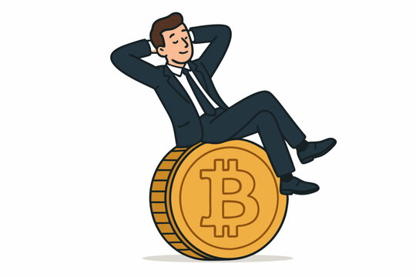
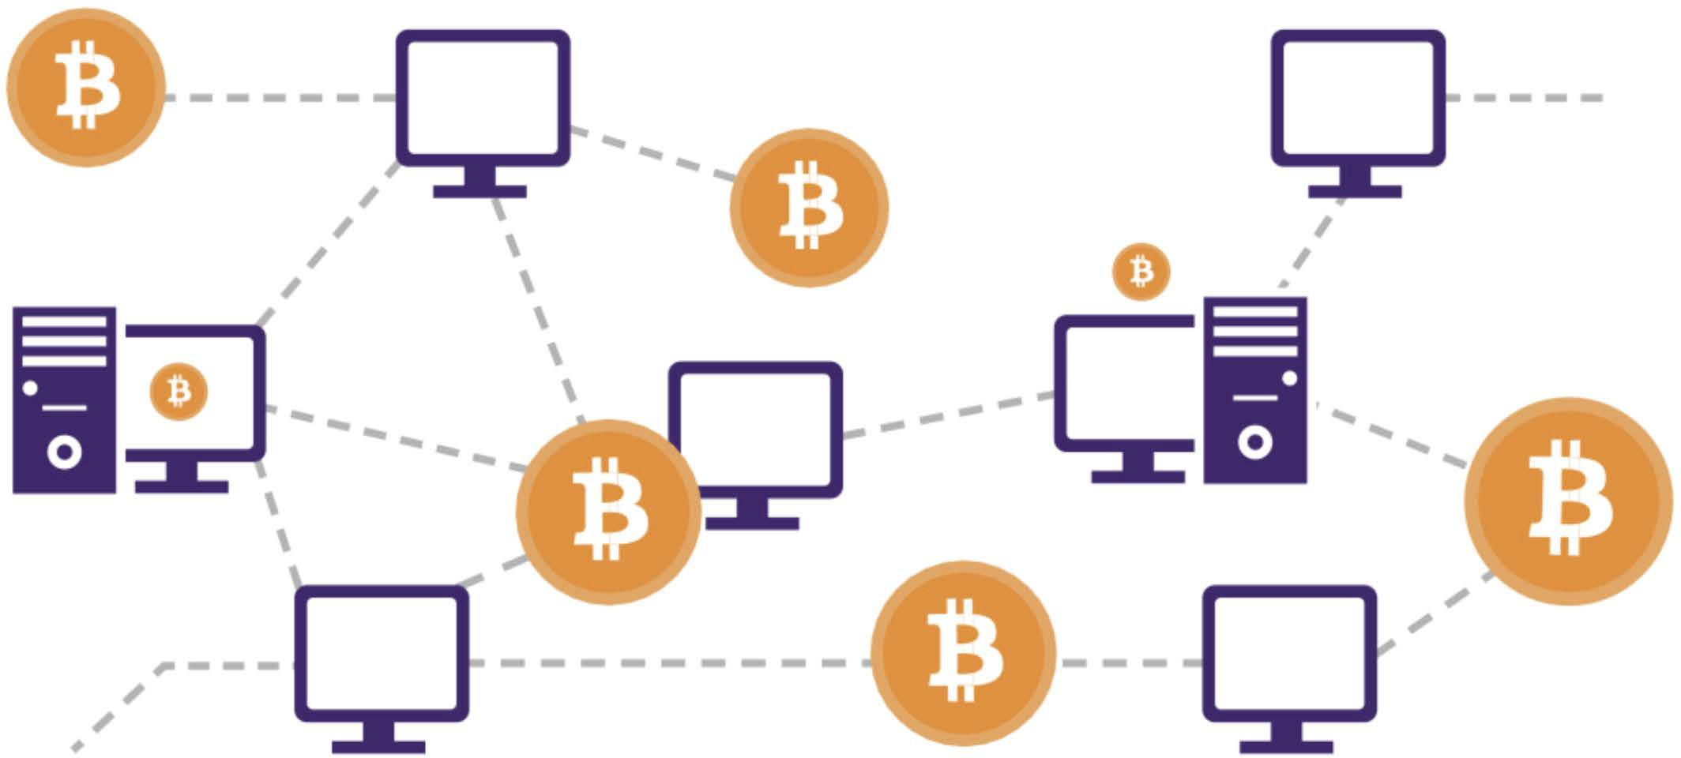
An Introduction to Bitcoin
2. Nodes: Gatekeepers of Validation
Bitcoin nodes are ordinary people who live across the planet. These participants server as the Bitcoin network’s gatekeepers by running Bitcoin software on their small computers on which they maintain a copy of the entire ledger. Nodes validate transactions and ensure that all participants adhere to the consensus rules.
By distributing the responsibility of validation across a network of nodes, Bitcoin remains resilient against attacks and maintains its trustless nature. Nodes play a crucial role in upholding the integrity of the ledger, contributing to Bitcoin’s decentralization ethos.
Users: Empowered Participants
Users — the lifeblood of the Bitcoin network — are individuals who engage in transactions. You can think of users as regular people who just live their lives but have also empowered themselves by integrating Bitcoin. For example, some users save their money in bitcoins while others, like citizens of El Salvador, use it as money to buy groceries and receive their salary in bitcoin.
Bitcoin empowers users by eliminating the need for intermediaries like banks and governments, allowing for direct peer-to-peer transactions. This also means that users have full control over their money, and transactions.

Slide 12
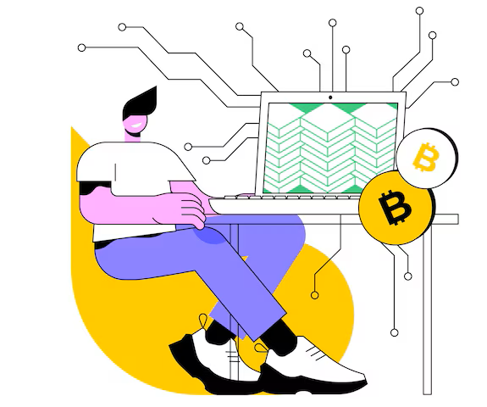
An Introduction to Bitcoin
Developers and Projects: Architects of Innovation
The monetary system of the future won’t build itself on its own, nor will it be globally adopted in an ethically correct way without eﬀort. That’s where Bitcoin developers and projects come into play.
Developers wield their technical expertise to enhance and innovate the Bitcoin protocol. These individuals contribute code, propose improvements, and address vulnerabilities, ensuring the network evolves in response to all types of challenges. Bitcoin's open-source nature invites collaboration, allowing developers worldwide to contribute to its growth.
The beauty of this decentralized development prevents a single entity from monopolizing control over the protocol. This happens through a consensus-driven process. Developers propose ideas and changes, and only those with the best ideas who are aligned with the broader vision for a better world receive support from the community, empowering Bitcoin’s transparent and democratic evolution until it’s ready for 8 billion people.
Bitcoin projects involve diverse groups, from mission-driven nonproﬁts and corporations to groups and individuals that create valuable content. These people work together on a speciﬁc goal or focus within the bigger Bitcoin mission toward collective freedom. Bitcoin projects play a crucial role in shaping and promoting the adoption of Bitcoin, working toward a future that prioritizes the empowerment and freedom of the human race.

Slide 13
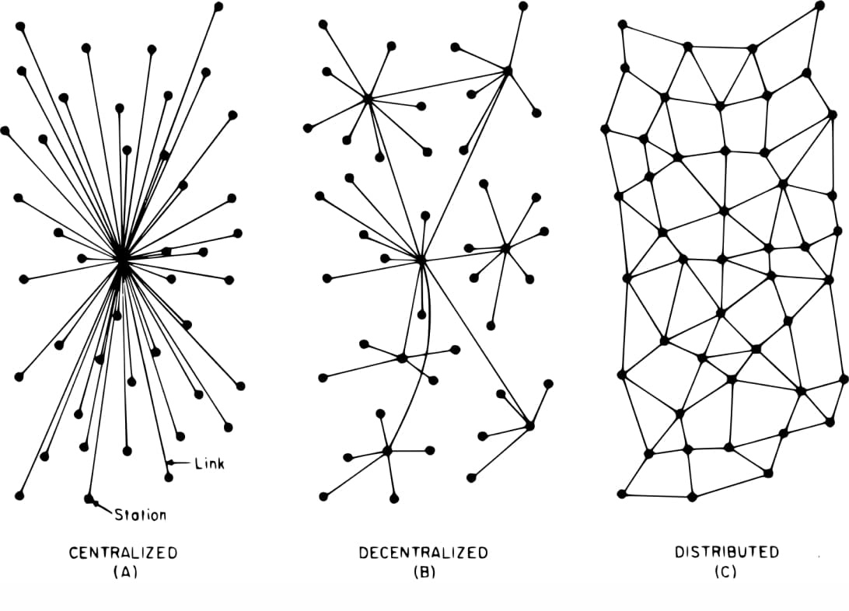


An Introduction to Bitcoin
The Symphony
Bitcoin's decentralization can be thought of as a synergetic musical orchestra, a balancing act where all the diﬀerent musicians make the most beautiful music together. There is no boss in the Bitcoin network; instead, miners, nodes, users, developers, and projects perform their roles with autonomy and collaboration.
The decentralized ledger, maintained by nodes, guarantees transparency, while the proof-of-work mechanism provides security and deters centralization in mining.
Users experience ﬁnancial sovereignty and empowerment free from the control of the ﬁat system. Developers, guided by consensus, ensure the protocol adapts to meet the evolving needs of humanity. Bitcoin projects, in their own unique ways, contribute to the broader mission of collective freedom.
As you can see, every participant plays a vital role in shaping Bitcoin's adoption and empowering humanity. Each participant in this decentralized orchestra contributes to the resilience and longevity of Bitcoin, creating a trust-free, borderless, and empowering ecosystem.
In summary, the symphony of decentralization in Bitcoin resonates as a testament to Satoshi Nakamoto's vision and the immense passion of a global community seeking freedom and empowerment.

Slide 14




An Introduction to Bitcoin
Bitcoin as Sound Digital Money
Introduction
Bitcoin is a new form of money; it is, “The Internet of Money," which means that it is open for anyone to join and start exchanging value with other users. Even the most isolated and poor communities in the world ﬁnally have access to a monetary system. Just like everyone who has a phone and an internet connection can use a search engine, Bitcoin makes it possible for everyone with a phone and internet connection to access a new, global monetary system.
In simple terms, Bitcoin is money. Bitcoin is not an investment but rather a safe, empowering way of saving your
hard-earned money.
Having bitcoins won’t make you rich because it won’t give you a return of more bitcoins. Its value, measured against a ﬁat currency, does go up, but this is only because of its growing adoption and the devaluation of ﬁat currencies.
Faster, Cheaper Payments
Financial Inclusion
Increased Privacy
Send money across the globe in minutes, with extremely low fees.
2.5 billion unbanked people can access money via a phone or a computer.
Bitcoin transactions are public, but your identity is not.
Bitcoin
Asset
Bitcoin
Network
Incentives
Innovation
Money
Networks
Hardware

Slide 15
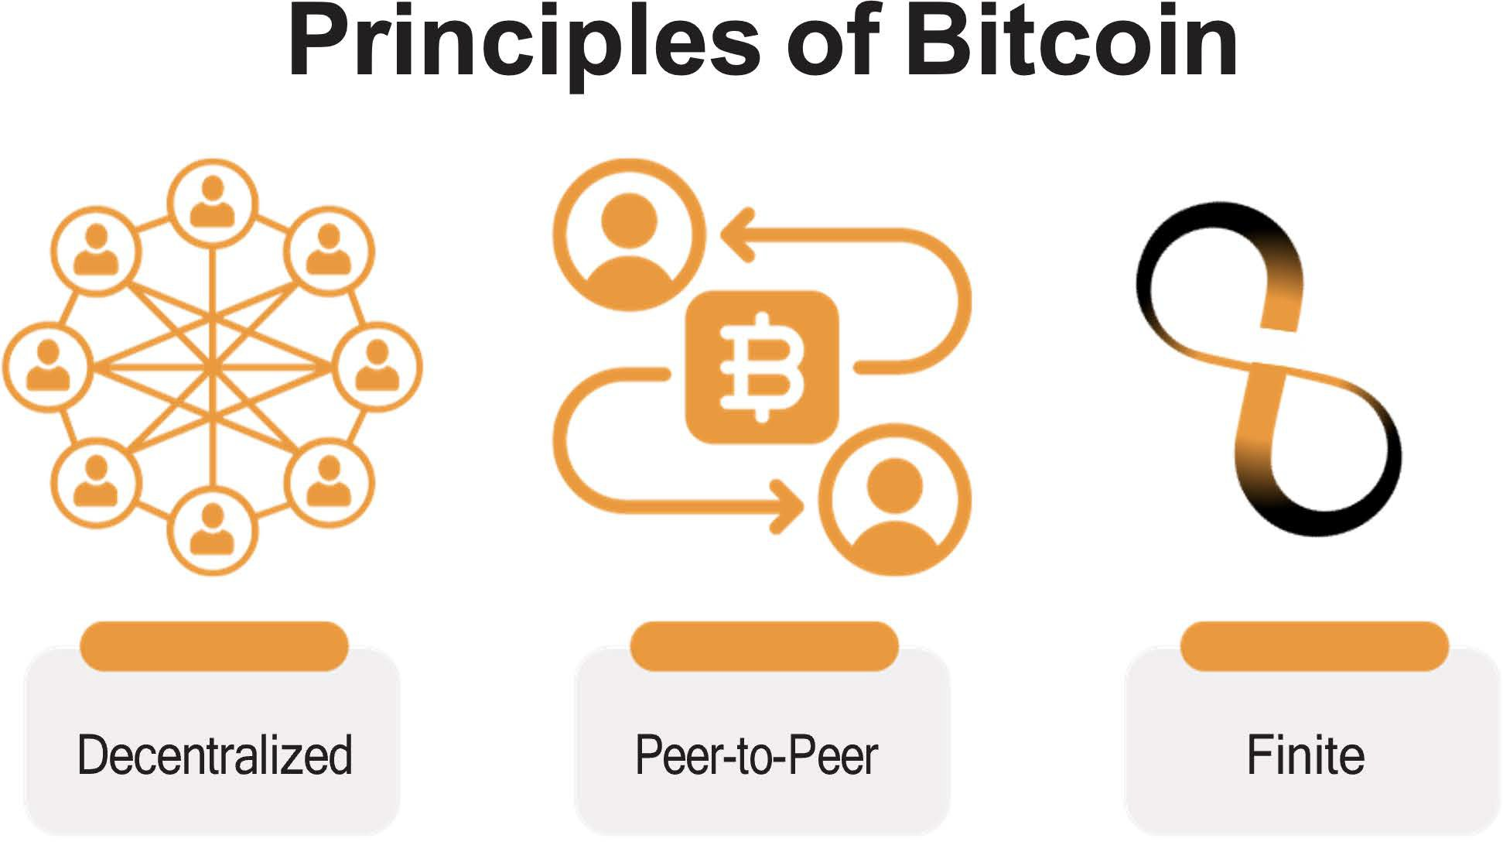
An Introduction to Bitcoin
Bitcoin is completely digital and borderless. It doesn’t matter where you are located because it lives on computers and smartphones from all over the world. Lots of users worldwide run the Bitcoin software and a copy of its ledger.
This software and record of all transactions has a very low chance of disappearing as there are countless copies of it. To shut it down, you would need to shut down the entire internet, forever, which is extremely unlikely to happen.
Finally, Bitcoin is scarce, which means that the number of bitcoin tokens that can exist is absolutely limited. No one can counterfeit Bitcoin — not even the most powerful governments and ﬁnancial institutions.

Slide 16
An Introduction to Bitcoin
Bitcoin’s Features
The Evolution of Sound Money
The lifecycle of sound money progresses through three stages to receive general acceptance from society: from being a store of value to becoming a medium of exchange and, ﬁnally, a unit of account.
The ﬁrst stage of money, a store of value, is when a currency starts gaining trust as a stable (or appreciating) asset over time. People who recognize this early seek to protect their wealth by storing it in this form of money, especially during a time of geopolitical and macroeconomic uncertainties.
Some groups, like media outlets, call Bitcoin a form of “digital gold.” This is because Bitcoin ﬁrmly established itself as a store of value during the past decade. Every day, more and more people start to view Bitcoin as a hedge against inﬂation, like gold was historically.
The next stage is when conﬁdence in a currency’s stability solidiﬁes. This is when the currency transitions into a medium of exchange, facilitating transactions in people’s daily lives. During this stage, the currency starts to become widely accepted for the exchange of goods and services.
Bitcoin is progressively moving toward becoming a medium of exchange. With growing merchant acceptance and the development of the protocol, Bitcoin transactions are becoming more eﬃcient and commonplace in daily commerce. One example of this is El Salvador, where Bitcoin is oﬃcially recognized as legal tender. Each day, more and more ordinary citizens and businesses are using Bitcoin as a medium of exchange.

Slide 17

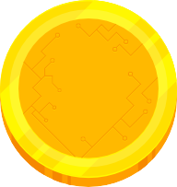
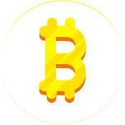

An Introduction to Bitcoin
Bitcoin’s Features
In the ﬁnal stage, a currency achieves the status of a unit of account, serving as a common measure for pricing goods and services. This is the stage in which it becomes the standard metric against which all other values are measured.
The journey toward becoming a unit of account is a more extended (long-term) process. The world currently measures goods and services only in ﬁat currencies, therefore, Bitcoin needs broader adoption and integration into various ﬁnancial systems. However, the foundation is already laid as businesses and individuals begin to consider and denominate values in Bitcoin.
Past
Future
Gold Standard Bitcoin Standard
As you can see, Bitcoin is well on its way in this evolutionary cycle of sound money. When Bitcoin becomes fully integrated into the global ﬁnancial system, it could become a standard unit of account, reshaping the entire global monetary system.

Slide 18




An Introduction to Bitcoin
Properties of Money
Over time, humanity has ﬁgured out that real sound money must possess certain properties to be eﬀective. These properties are durability, divisibility, portability, acceptability, scarcity, and fungibility.
Let’s see if Bitcoin passes the test.
Durability - Bitcoin is purely digital and thus completely durable.
Divisibility - For comparison, the ﬁat currency USD can be divided to the cent (.01). Bitcoin can be divided into what is known as a satoshi or sat (.00000001). And because of Bitcoin’s digital character, it can be divided even more in the future if humanity needs it. Bitcoin is currently the most divisible monetary asset in the world.
Portability - In April 2020, $1.1 billion was transferred in just a few minutes, and it only cost 68 cents. No other way of paying can move that much money, at such a low cost, so quickly, and all on its own. This is what makes Bitcoin the most easily movable form of money in the world.
Acceptability - Bitcoin is still in its early stages of becoming a medium of exchange, and compared to ﬁat currencies, the acceptability of Bitcoin is currently low.
Scarcity - There will only ever be 21 million bitcoins in existence. It’s, by code, impossible for this amount to ever increase, which means that Bitcoin is not only scarce, but the scarcest monetary asset in the world.
Fungibility - Each unit of bitcoin is the same as any other unit of bitcoin and can be interchanged and transacted over the Bitcoin protocol on a like-kind basis, which makes it a fungible currency.

Slide 19







An Introduction to Bitcoin
Bitcoin vs. Gold vs. US Dollar
Bitcoin is a type of smart money that's programmable, can't be taken away, and has all the qualities that make it great for saving and easy for merchants who want fast transactions.
Since it's a transparent digital ledger, Bitcoin can be super eﬃcient in catching fraud and ﬁguring out risks in its services. It has the good aspects of gold, such as there only being a limited amount of it, but it also has the beneﬁts of ﬁat currencies because you can divide it and carry it around easily. Plus, it brings in new features that work well in our digital world.
What do you think? Bitcoin is not yet widely recognized and adopted, but is it sound money?
Properties of Money
Gold
Fiat
Bitcoin
Durability
High
Moderate
High
Portability
Moderate
High
High
Divisibility
Moderate
Moderate
High
Fungibility
High
High
High
Scarcity
Moderate
Low
High
Veriﬁable
Moderate
Moderate
High
Established History
High
Moderate
Low
Censorship Resistant
Moderate
Moderate
High
Smart/Programmable
Low
Moderate
High
"Bitcoin vs Gold vs US Dollar" Bitcoin Magazine, https://bitcoinmagazine.com

Slide 20
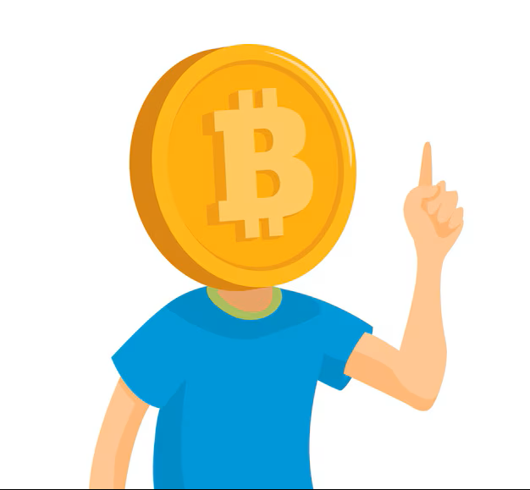

An Introduction to Bitcoin
Embracing Personal Responsibility
The result is a distributed system with no single point of failure. Users hold the crypto keys to their own money and transact directly with each other, with the help of the P2P network to check for double-spending.
Satoshi Nakamoto
In the ﬁat world, people rely on governments, banks, and established payment providers. The heads of these (ﬁnancial) institutions set the rules of the network, and the participants, mostly ordinary citizens, must comply with these rules. It doesn’t matter where you live - there are always a set of standard procedures that instruct you on what to do and how to do it. Over time, this led to a cycle of hardship, particularly for families that struggle with the increasing challenges of daily life.
Because of this system, people are accustomed to putting the responsibility for their ﬁnances in the hands of others. For example, most people rely on someone else to help them, especially when something goes wrong (like losing access to your bank account).

Slide 21






An Introduction to Bitcoin
Bitcoin has already won
As you know, the monetary system of Bitcoin is very diﬀerent. Bitcoin operates in a speciﬁc way, and rulers have been replaced by an autonomous system of rules.
There is no dictator or leader, which also means that no one will dictate to you what you need to do. If you want the newfound freedom and empowerment of Bitcoin, you will need to learn how it works and integrate the technology in a way that works for you personally.
With Bitcoin, you are fully in control of your funds, but with this additional control comes increased responsibility. For example, losing access to your bitcoins by losing your keys to your digital wallet means you have lost your savings, permanently.
There's no customer service hotline to call or someone else to turn to, when there is a problem, you need to take care of it yourself.
Fortunately, this will not happen to those who decide to take full responsibility over their own lives. Using Bitcoin is not inherently complicated; it’s just a new concept.
Any discomfort arises because it's unfamiliar, but if you are willing to learn how to use Bitcoin and fully embrace the responsibility of safeguarding your wealth, Bitcoin becomes an empowering tool — you are in control, and no one can seize your wealth.
Unit
Settlement
Issuance
Cent 0.01
Sat
0.00000001

Slide 22
Q&A

Slide 23
THANK YOU

Slide 25
How to Use Bitcoin

Slide 26




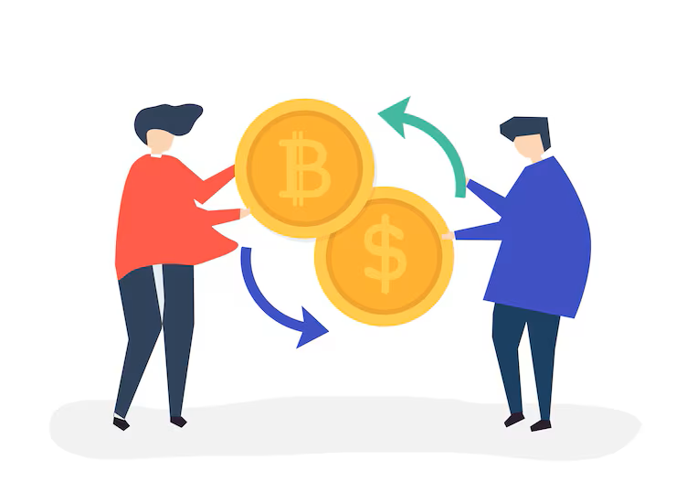
How to Use Bitcoin
Introduction
Acquiring and Exchanging Bitcoin
There are many ways to acquire bitcoin. For example, you can:
Mine bitcoins (more on that in coming Chapter)
Get paid in bitcoins in exchange for your work and pay for other people’s products and services with bitcoins (more on that in coming Chapter)
Exchange your fiat currency for bitcoins or exchange your bitcoins for fiat currency in person.
Exchange your fiat currency for bitcoins or exchange your bitcoins for fiat currency online.
Why would anyone trust nerd money vs. central bank money? Nerds brought you the internet. Banks brought you the Great Depression.
Andreas M. Antonopoulos
Now that we have a better understanding of what Bitcoin is and its purpose, it's time to learn how to use it practically.
We'll guide you through the process of acquiring bitcoins step-by-step, explore the various types of wallets available, help you set up your own Bitcoin wallet, and even practice sending and tracking a bitcoin transaction on the network. It's time to turn your understanding into action!
Excha^{nge}

Slide 27
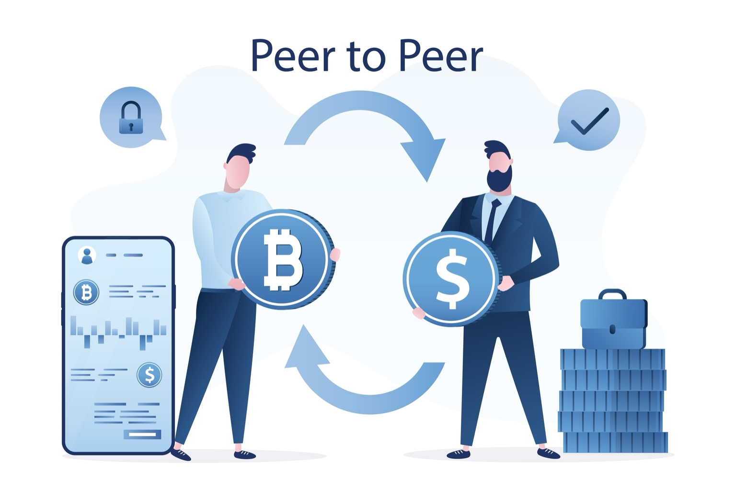
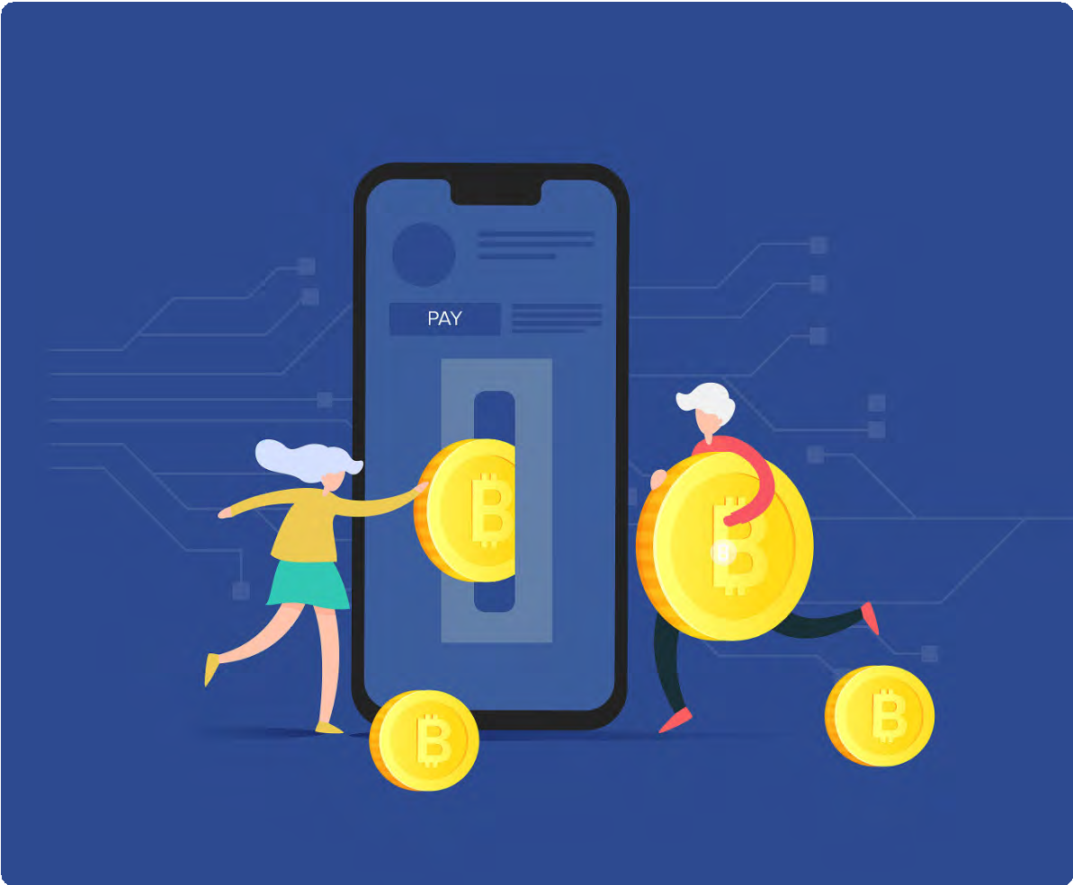
How to Use Bitcoin
Peer-to-Peer: In Person
Engaging in peer-to-peer (P2P) transactions to acquire and sell bitcoin involves directly exchanging your fiat currency (or any other goods or services) for bitcoins with another individual, eliminating the need for a bank or other party to be involved in the transaction.
Both parties mutually determine the exchange amount and rate. The buyer provides the cash, the seller transfers the bitcoins, and the transaction concludes. While it’s easier to do P2P exchanges physically by meeting with the other individual directly in the real world, you can also do so from virtually anywhere thanks to the internet. Additionally, exchanging bitcoins for fiat currency follows a similar process in reverse.
Peer-to-Peer: Online
Enter P2P platforms, where Bitcoin buyers and sellers meet in cyber space to conduct transactions without any intermediaries, directly on the internet.
With such platforms, you don’t have to trust anyone with your information or money; you can meet other peers and trade with them directly. On most P2P platforms, peers have to escrow some of the funds to ensure they will comply with their part of the deal. Escrow means putting the money in a safe place that the platform controls until both parties do what they promised. It's like a trusted friend holding onto your stuff until everyone keeps their word.

Slide 28




How to Use Bitcoin
Centralized Exchanges
Using centralized exchanges may be the easiest way to acquire and sell bitcoins but it also involves significant trade-offs. Centralized exchanges are companies that allow clients to buy and sell bitcoins directly through them. However, this convenience comes at a cost.
Centralized Exchanges and Their Trade-Offs
It’s important to note that when buying bitcoins through a centralized exchange, you are often required to provide personal information and verify your identity. This creates a risk of identity theft and exposes your personal information to potential threats. Additionally, centralized exchanges hold your bitcoins for you, which means you are not in control of your money until you withdraw it from them.
To add to these concerns, centralized exchanges can misappropriate users’ funds or lend more bitcoins than they have in reserves until they collapse. Yes, just like banks! However, in the Bitcoin world, there is no central bank to bail out fraudulent banks by printing more currency because you can't print more bitcoins!
CENTRALIZED

Slide 29
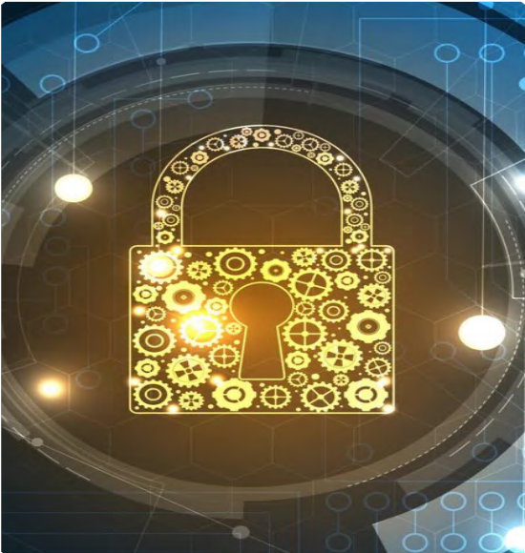


How to Use Bitcoin
Introduction to Bitcoin Wallets
Unlike physical money, bitcoins are not actually present in a Bitcoin wallet. Instead, they live on the distributed ledger that the Bitcoin network constantly verifies and secures. So, how can you own bitcoins? You have ownership of your bitcoins only when you own the private keys allowing you to sign transactions and transfer ownership of your bitcoins to someone else.
This is the act of sending bitcoins. With that in mind, let’s take a look at two concepts we describe when using the term “wallet”:
A master private key (like a password) from which you can generate public keys that you can share with others to receive and send bitcoins.
The mobile or desktop interface from which you can interact with the Bitcoin network to retrieve your bitcoin balance, send and receive transactions, and broadcast them to the network. Different types of wallets, along with their benefits and tradeoffs, will be described in the next section.

Slide 30





How to Use Bitcoin
Self-Custodial vs .Custodial Wallets
Before detailing the different types of Bitcoin wallets and their characteristics, let’s make an important distinction between self-custodial and custodial wallets, as shown in the table below. You can see the benefits and risks of using each wallet type and who controls the bitcoins in each case. Self-custodial means the user holds the private keys, which means they are in true possession of their bitcoins, while in the second type, a third party, holds their bitcoins.
Wallet Type | Who controls my bitcoin? | Benefits | Risks
Self Custodial Wallets | The user | Complete control over funds and transactions, no approval process or account freeze, no corporate or government control, protected against arbitrary confiscation, like keeping money at home. | No recovery if recovery phrase is lost, less customer support, full responsibility falls on the user.
Custodial Wallets | The third-party provider | Easy recovery if access is lost, easier customer support. | Funds are always connected to the internet, so more vulnerable to hacking and breaches. Custodians control and can freeze accounts.

Slide 31







How to Use Bitcoin
In a self-custodial wallet (also called non-custodial wallet), you are the only one with the keys to the wallet and you have full control over what goes in and out. On the other hand, in a custodial wallet someone else holds the private key, giving them full access to move any bitcoin that wallet controls on your behalf.
Self-custody is like being your own bank. Transactions are not subject to control or authority by any government or company, but it also means you bear full responsibility for keeping your bitcoins secure.
Self-custody ensures that third parties cannot confiscate your bitcoins without your consent.
Self-custody gives peace of mind in times of uncertainty, knowing your bitcoins are secure.
It’s important to choose the right type of wallet for each individual’s needs. Sometimes, people find it hard to distinguish whether they are installing a self-custodial or a custodial wallet. This table shows the differences with the installation process.
Wallet Type | Step 1: Choose a Wallet | Step 2: Install the Wallet | Step 3: Create a New Wallet | Step 4: Secure Your Seed Phrase | Step 5: Start Using Your Wallet
Self Custodial Wallets | Choose a self-custodial wallet provider | Follow the wallet provider’s instructions | Generate a recovery phrase and at least one private key | Store the recovery phrase in a secure location | Start using the wallet to receive and send bitcoins
Custodial Wallets | Choose a custodial wallet provider | Follow the wallet provider’s instructions | Create an account with the wallet provider | N/A (wallet provider holds the private keys) | Start using the wallet to receive and send bitcoins

Slide 32

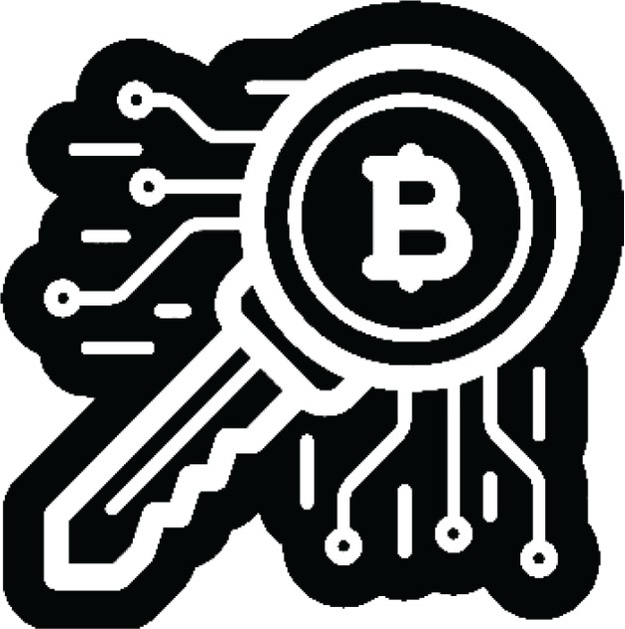
How to Use Bitcoin
“Not your keys, not your coins” is a popular saying among bitcoin holders. It refers to the idea that if you don’t have direct control over the private keys associated with your Bitcoin wallet, you don’t have true ownership of the coins.
Whoever accesses your private keys will gain ownership of your bitcoins. This is why it is of the utmost importance to protect them by keeping them away from prying eyes! We’ll see a few ways you can do that later in the book.
For what follows, we’ll be talking about self-custodial wallets only, where the user owns their keys and has complete control over their bitcoins. Don’t worry if it seems complicated or you don’t understand everything - this is a journey, and you will understand more as you start using Bitcoin more!
NOT YOUR KEYS
NOT YOUR COINS

Slide 33



How to Use Bitcoin
Different Types of Bitcoin Wallets
Depending on where your private key is created and stored, we commonly use different names to describe Bitcoin wallets. If the keys are stored on your smartphone, we call it a “mobile wallet.” If they’re stored securely on a dedicated device, we call it a “hardware wallet.” If the key is only stored on paper, then it is called a “paper wallet.”
The different names we give to Bitcoin wallets
depending on their structure:
Wallet Type | Description | Advantages | Disadvantages | Example User
Online Wallet | A wallet accessed through a web browser. | Accessible from any device with an internet connection. Easy to use. | Less secure. Can be hacked or compromised. | Someone who needs to access their wallet frequently and doesn’t have a lot of funds to store.
Mobile Wallet | A wallet installed on a mobile device. | Convenient. Can be accessed from anywhere. | Can be lost if the device is misplaced, stolen, or hacked. | Someone who needs to access their wallet frequently and doesn’t have a lot of funds to store.
Desktop Wallet | A wallet installed on a desktop computer. | More secure than online wallets. Can be used oﬄine. | Can be hacked if the computer is infected with malware. | Someone who wants to store a large amount of bitcoins and is comfortable with using a desktop computer.
Hardware Wallet | A physical device that stores bitcoins oﬄine. | Very secure. Can be used oﬄine. | Funds could be unrecoverable if the device is lost or stolen. | Someone who wants to store a large amount of bitcoins and is willing to pay for the added security of a hardware wallet.
Paper Wallet | A physical record of a Bitcoin wallet’s private and public keys. | Very secure. Can be used oﬄine. | Very secure. Can be used oﬄine. | Someone who wants to store a large amount of bitcoins and is willing to take added precautions to ensure its security.

Slide 34




How to Use Bitcoin
Because the keys can be moved from one device to another, the “status” of your Bitcoin wallet is not definitive.
For example, if I generate the keys of my Bitcoin wallet on a computer and later upload them to my phone, the “desktop wallet” then becomes a “mobile wallet.”
When choosing a Bitcoin wallet, there are several things you should consider:
Security: Make sure the wallet has strong security measures in place such as two-factor authentication and secure password policies.
Privacy: Consider whether the wallet allows you to remain anonymous or if it requires personal information to set up an account.
Ease of use: Choose a wallet that is easy to use and navigate, especially if you are new to Bitcoin.
Compatibility: Make sure the wallet is compatible with your device and operating system.
Fees: Compare the fees charged by different wallets to make sure you are getting the best deal.
Reputation: Research the reputation of the wallet and its team to make sure it is trustworthy.
Control: Some wallets give you more control over your private keys, which can be a security advantage.
When it comes to storing your bitcoins, it’s not just about who has control over them — there are many other risks to consider. That’s why it’s important to find a storage solution that is both secure and convenient.
When you analyze the trade-offs of the various types of wallets, you will learn that there is no ideal wallet to satisfy all needs.
Consider whether you want a wallet that gives you full control or one that is more user friendly but may have less control.

Slide 35


How to Use Bitcoin
Open Source vs. Closed Source
Another important factor to keep in mind when choosing a Bitcoin wallet is knowing if the application or software is open-source. Open-source code is very important because it allows the community to review the code and continue developing the project if the team were to stop working on it.
Just as Bitcoin’s code is completely open for everyone to review, use, and modify, so should be the code of the wallet you use to store your bitcoins.

Slide 36

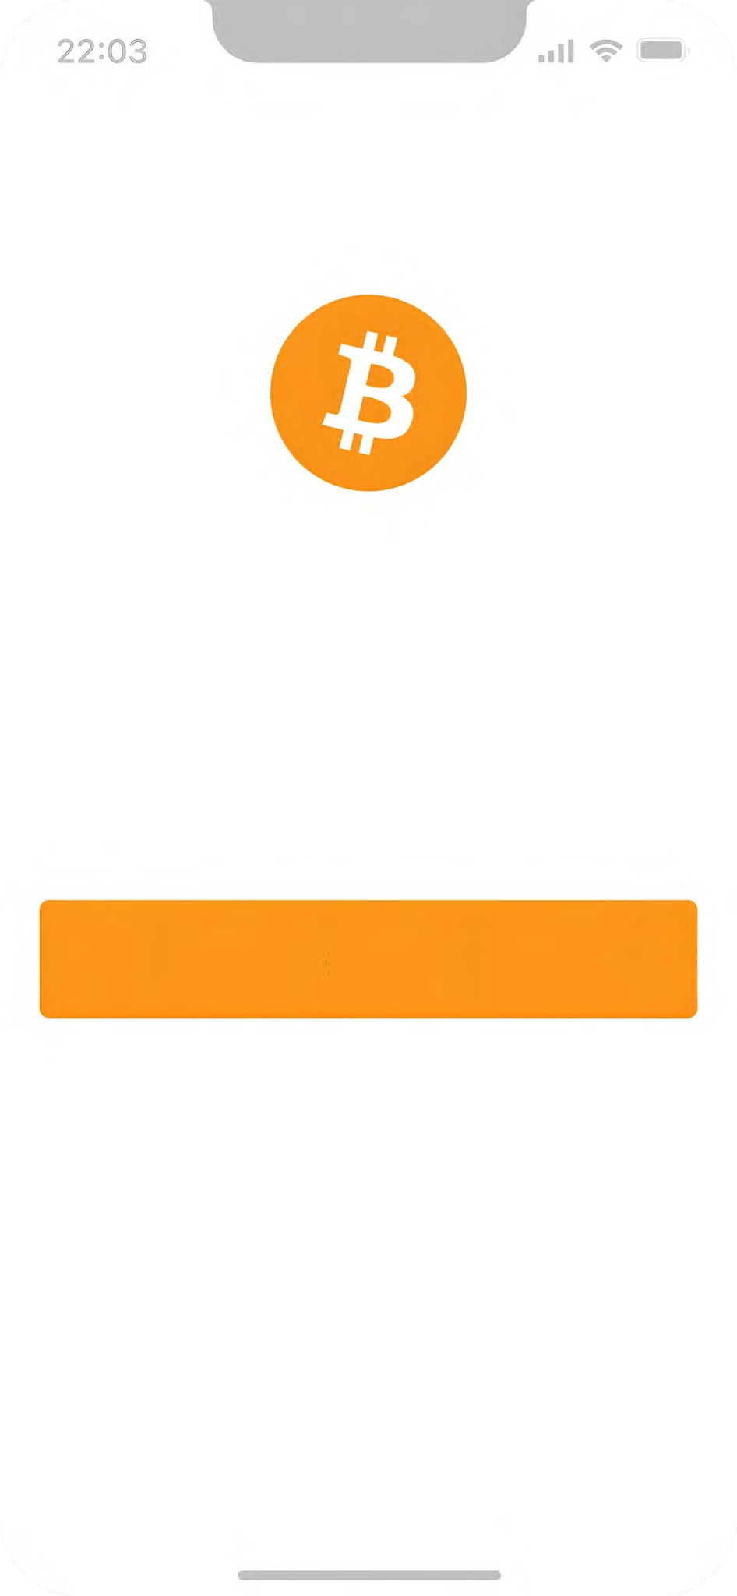
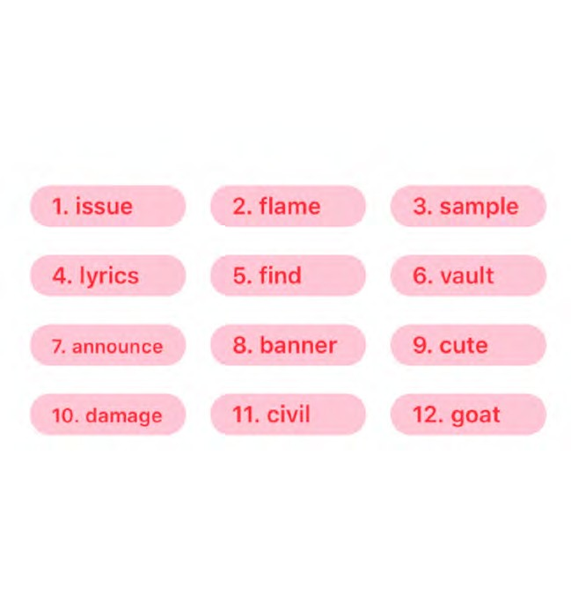
How to Use Bitcoin
Setting up a Mobile Bitcoin Wallet
Now that we have a better understanding of Bitcoin wallets and the differences between them, we’ll see how to use one in practice. For this example, we’ll create a mobile wallet directly on our smartphone.
Class Exercise: Option 1 — Download a new wallet.
How to create and use a Bitcoin wallet:
Search for the app in the App Store (iOS) or Google Play Store (Android).
Open the app and type in your 12- or 24-word recovery phrase (sometimes called a seed phrase). Be sure to write it down and keep this in a safe place! This recovery phrase allows you to recover full access to your funds if needed.
Your Seed Phrase
Your Seed Phrase is used to generate and recover your account.
Remember that if you lose or forget this sequence of words, you will not be able to access your bitcoins if you lose access to your wallet.
Bitcoin wallet
A simple bitcoin wallet for your enjoyment.
You must then confirm that you have actually saved your recovery or seed phrase. To do this, you must enter, in the same order, the words of your seed phrase.
As an additional measure of security, some wallets allow you to choose a secure password. Your private key and first Bitcoin address are automatically created for you by your wallet.
Use your “receive” address to receive bitcoins. Transfer bitcoins to your wallet. With a self-custodial wallet, you cannot always buy bitcoins directly with fiat, so you might need to purchase and transfer them from an exchange first.
Please save these 12 words on a piece of paper. The order is important. This seed will allow you to recover your account.
Create a new wallet
Think of your public key as your email address, you want to share this with others so that they can send you bitcoins, or, in the case of an email address, an email.
Think of your private key as the password to your email, you wouldn’t want to share this with anyone, as it would give them access to your email.
Restore existing wallet
5
Your wallet, your coins
100% open-source & open-design

Slide 37

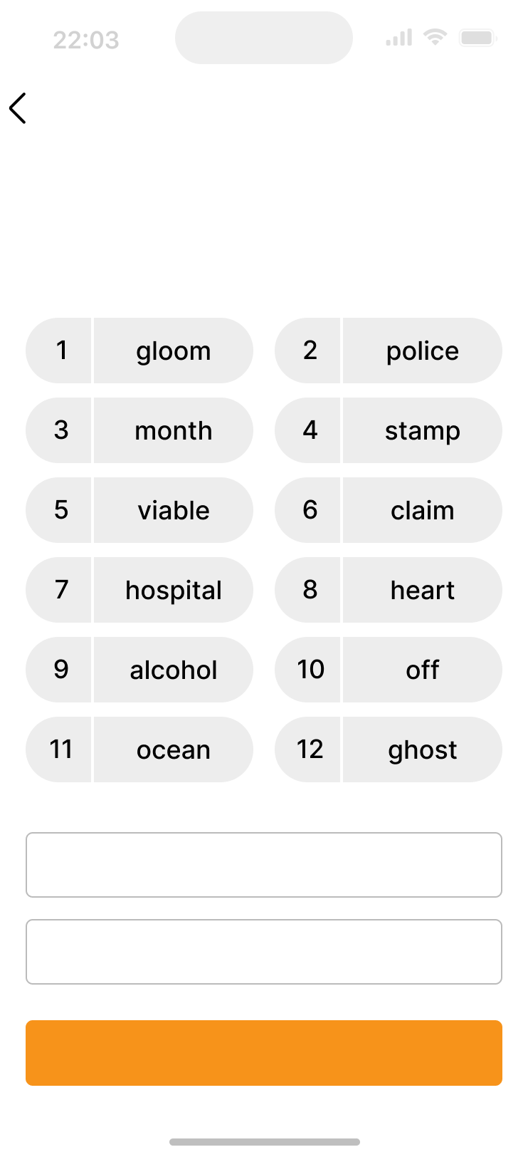

How to Use Bitcoin
Class Exercise: Option 2 - Restore a wallet (Time-Limited).
Back
This is you recovery phrase
Make sure to write it down as shown here. You have to verify this later.
Download a Bitcoin wallet and add some satoshis for each student.
Give each student a sheet with a seed phrase to retrieve a wallet.
When you first start your wallet, you will see three methods of wallet creation, tap [Import an existing wallet]. You will see an introduction screen, tap [Restore with recovery phrase].
Enter your 12/18/24-word recovery phrase one by one, in the correct order.
Touch [Restore] when finished.
You will see an “Import Successful” message when your wallet has been successfully imported.
Backup to iCloud
Print template
Verify

Slide 38
How to Use Bitcoin
Receiving and Sending Transactions
A bitcoin transaction is a transfer of ownership of existing bitcoins to a new owner. However, instead of transferring actual coins, all the nodes in the network update their local copy of the public ledger to reflect the change in ownership.
When sending a bitcoin transaction, the sender signs a message that only they can sign with their private key, signaling to the network that the ownership of the bitcoins has changed to the recipient’s address.
The bitcoins will now be tied to an address that only the new owner can send from, giving them ownership of the bitcoins.

Slide 39



How to Use Bitcoin
Receiving and Sending Transactions
New bitcoin transactions are initiated from wallets around the world, but there is no central payment processor.
Instead, miners around the world compete to record transactions in the ledger. Let’s say Jim owes Eliana 0.5 BTC and is ready to pay her back. Both have digital wallets.
Eliana shares her address with Jim
Jim uses his wallet software to create the transaction, which includes Eliana’s address, the amount to be transferred (0.5 BTC), and a fee for the miner.
After signing the transaction, it is broadcast to the network, where it is verified by nodes. Nodes check the transaction for validity and ensure that Jim has enough funds. If he does not, they reject the transaction immediately.
Once the transaction is verified, miners add it to the blockchain, and the funds are transferred to Eliana’s address.
Eliana can then use her private key to access the transferred funds in her wallet.
LEDGER
LEDGER
Account Owner | Value
Sam | 2.50
Michael | 6.00
Robert | 2.00
Adam | 3.00
Jim | 1.50
Eliana | 1.75
Daniel | 5.25
Account Owner | Value
Sam | 2.50
Michael | 6.00
Robert | 2.00
Adam | 3.00
Jim | 1.50
Eliana | 1.75
Daniel | 5.25
Bitcoin Transaction Request Message
Jim sends
0.50 BTC to Eliana
Jim Eliana
0.50 BTC
It’s important to note that once the transaction is complete, it cannot be reversed.

Slide 40













How to Use Bitcoin
How a Bitcoin Transaction Works
Someone requests a transaction
Transaction broadcasted to P2P computers (nodes)
Miners verify the transaction
Transactions combined to form a data block
New block added to the existing blockchain
The transaction is complete

Slide 41
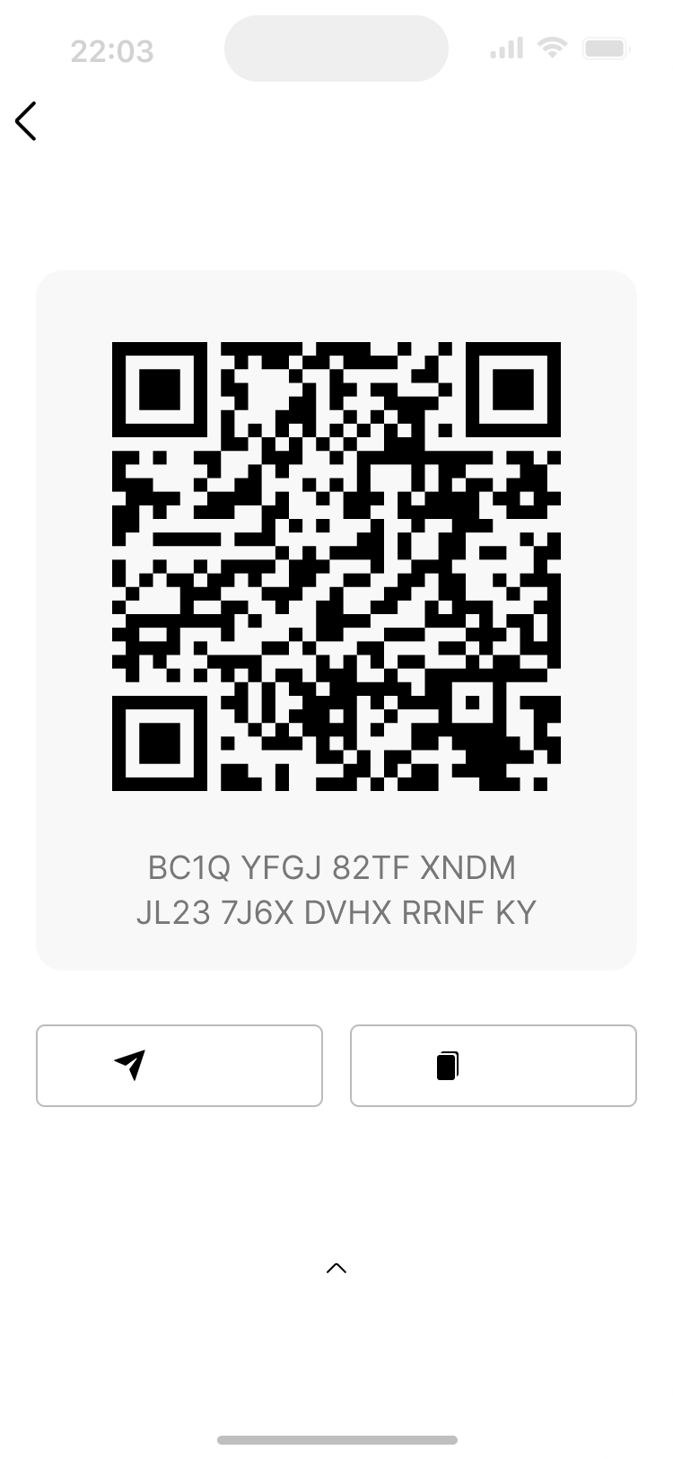
How to Use Bitcoin
Receiving Bitcoin Transactions:
Back Done
Share payment request
To receive bitcoins, you will need to provide the sender with your Bitcoin wallet address. This is a unique string of letters and numbers that represents your wallet and is used to identify it on the Bitcoin network.
You can find your wallet address by logging into your Bitcoin wallet and looking for an option to “Receive” or “Deposit” bitcoins.
You can then share your Bitcoin address with the sender in one of several ways:
Copy and paste the address: You can copy the address by highlighting it and pressing “Copy” on your keyboard, then paste it into an email or message to the sender.
Share a link to your Bitcoin wallet: Some Bitcoin wallets allow you to create a link to your wallet that you can share with the sender. They can then click on the link to access your wallet and send the bitcoins.
Share a QR code: If the sender has a smartphone with a Bitcoin wallet app, they can scan the QR code to get your Bitcoin address.
Once the sender has your Bitcoin address, they can send you bitcoins by entering your address and the amount they want to send you and initiate the transaction.
The bitcoins will then be sent to your wallet and will be visible once the transaction is confirmed on the Bitcoin Network. This usually takes a few minutes. Next, we will take a look at sending bitcoin transactions.
Share
Copy
Details & Address Settings

Slide 42
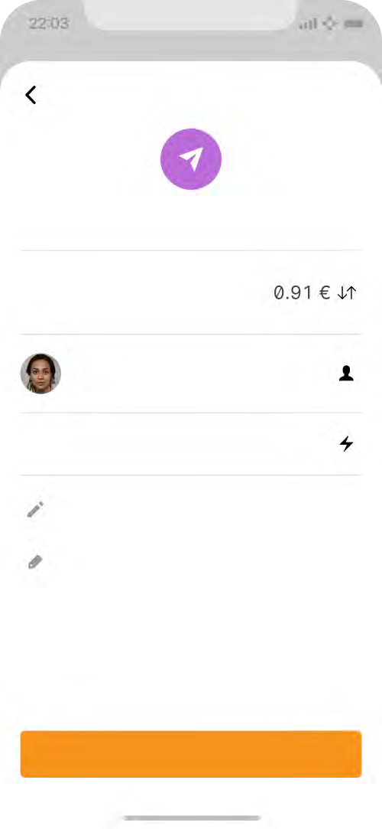
How to Use Bitcoin
Sending Bitcoin Transactions:
Back
Cancel
To send bitcoins, you will need a few things: a Bitcoin wallet, the recipient’s Bitcoin address, and the amount of bitcoins you want to send.
Open your Bitcoin wallet. An SMS code will be sent to your phone number, and you will need to enter it in the dialog box. Alternatively, if you have enabled Google 2FA, you will need to enter the six-digit code from the Google Authenticator app.
Navigate to the “Send” or “Withdraw” feature and copy the recipient’s address.
Enter the recipient’s Bitcoin address by pasting it in the “To” field.
Enter the number of bitcoins you want to send in the “Amount” field.
Double-check the recipient’s address and the amount to be sent.
Before clicking “Confirm and Send,” we recommend you double-check the transaction details one more time to ensure that you are sending the correct amount of bitcoins to the correct wallet address.
Confirm the transaction and wait for the network to confirm the transaction.
Send bitcoin
Amount
2,000 sats
To
Jane Richardson
Fee
~3 sats
Add note
Add tags
Now you know how to evaluate, select, and set up a self-custodial Bitcoin wallet. Sending bitcoins from one wallet to another on the Bitcoin network is called sending an “on-chain” transaction. This is because the transaction occurs on the main Bitcoin network blockchain. On-chain transactions are the safest way to transact with bitcoins. However, on-chain transactions are slower and can be significantly more expensive than other options, such as the Lightning transactions we will discuss in Chapters ahead
Send payment

Slide 43

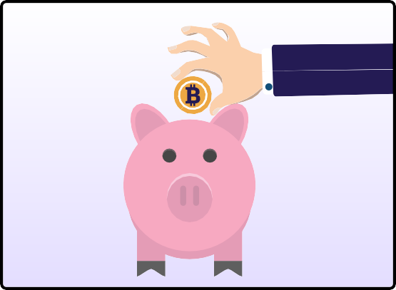
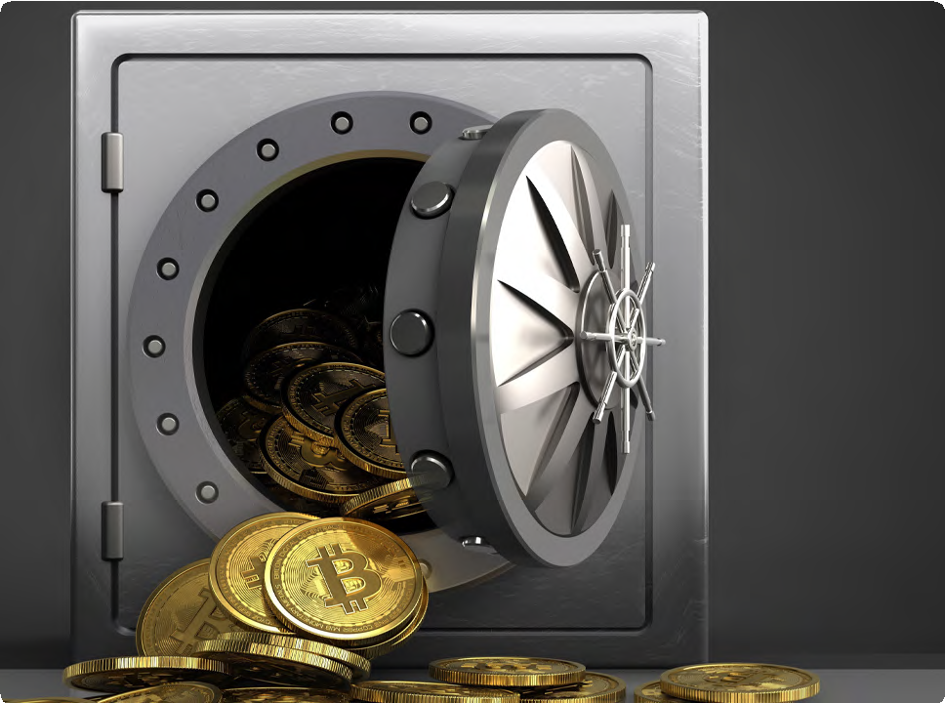
How to Use Bitcoin
Saving in Bitcoin
Bitcoin is a way to safeguard your money against inflation and protect it from being controlled by anyone else, if you do it correctly. Saving in bitcoins provides a vehicle to store, accumulate, and build wealth over time. As you understand by now, the type of money you choose to save is one of the most important decisions you can make. Choosing wisely allows you to build a better future for yourself and your family.
Peace of Mind: When stored properly, Bitcoin is the only form of property no one can take away from you.

Slide 44

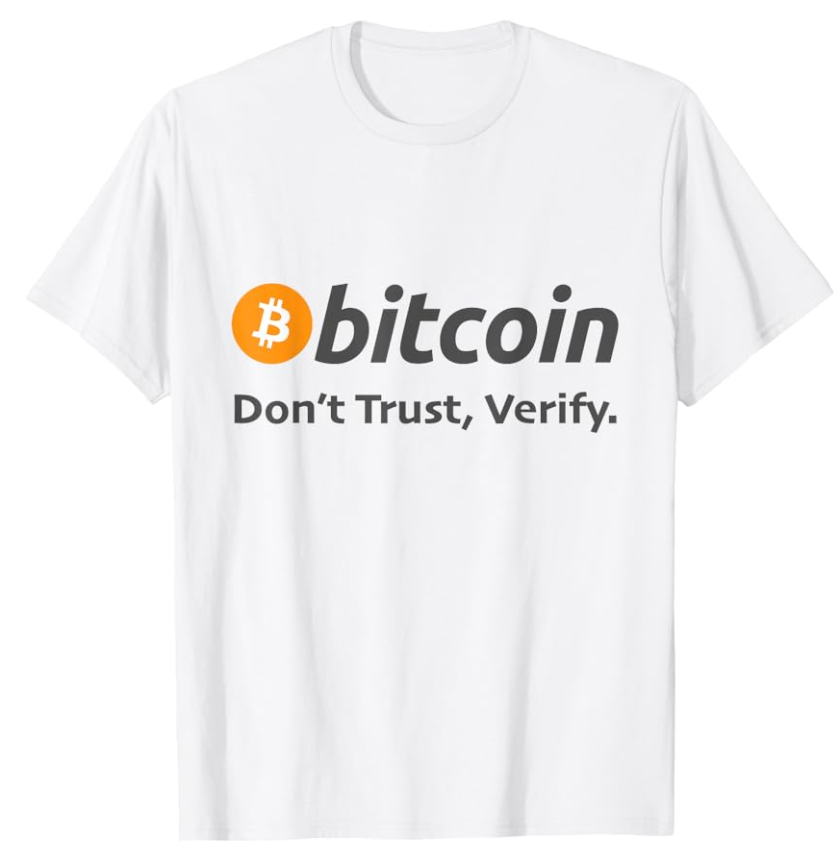
How to Use Bitcoin
Don’t Trust, Verify
Whatever you do in Bitcoin, remember this: “Don’t Trust, Verify.” There are no leaders in Bitcoin. You should never blindly follow someone’s claims. Rather, you should always question what you’re being told and verify it for yourself. By following this mantra, you’ll protect yourself from losing your bitcoins. This goes for claims such as “the next Bitcoin” just as it does for “investment opportunities” or promises of “quick and easy profits.”
In summary, you have been given the important skills to use Bitcoin in your everyday life. You have learned how to get and exchange bitcoin in different ways and how to keep it safe using various wallets.
By setting up your mobile Bitcoin wallet and making transactions with others, you now have the hands-on experience to confidently use Bitcoin day-to-day. By understanding Bitcoin as a way to save money and following the idea of “Don’t Trust, Verify," you're now in control of your money.
In the upcoming chapter, we will explore the Lightning Network. We will look at how this innovative technology is changing the way people worldwide access and use money. From everyday transactions to more advanced applications, you will learn how the Lightning Network empowers individuals, communities, and businesses by providing them access to financial services.

Slide 45
Q&A

Slide 46
THANK YOU

